Slide 1
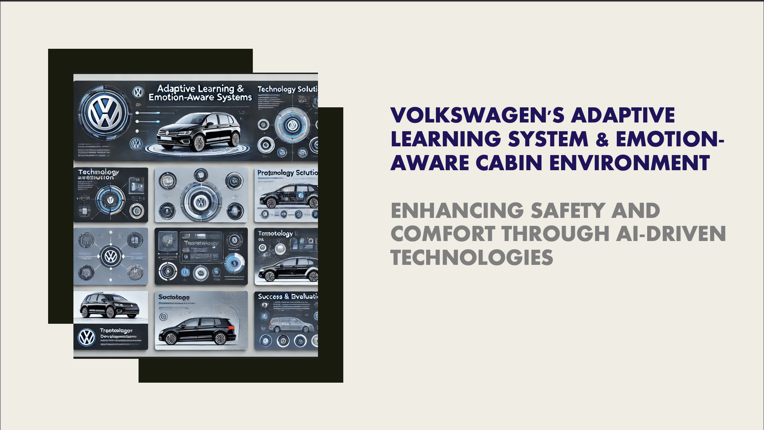
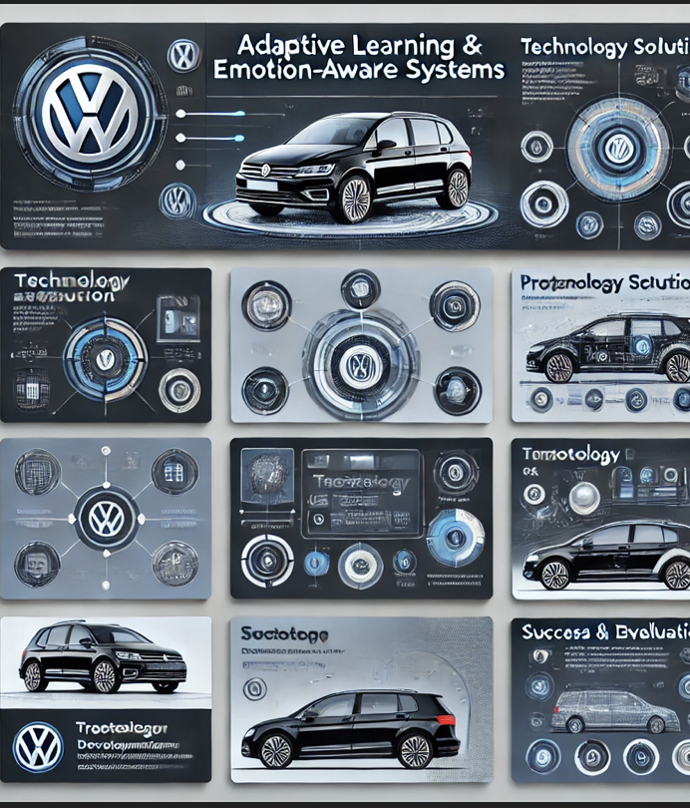
Volkswagen's Adaptive Learning System & Emotion-Aware Cabin Environment Enhancing Safety and Comfort through AI-Driven Technologies

Slide 2
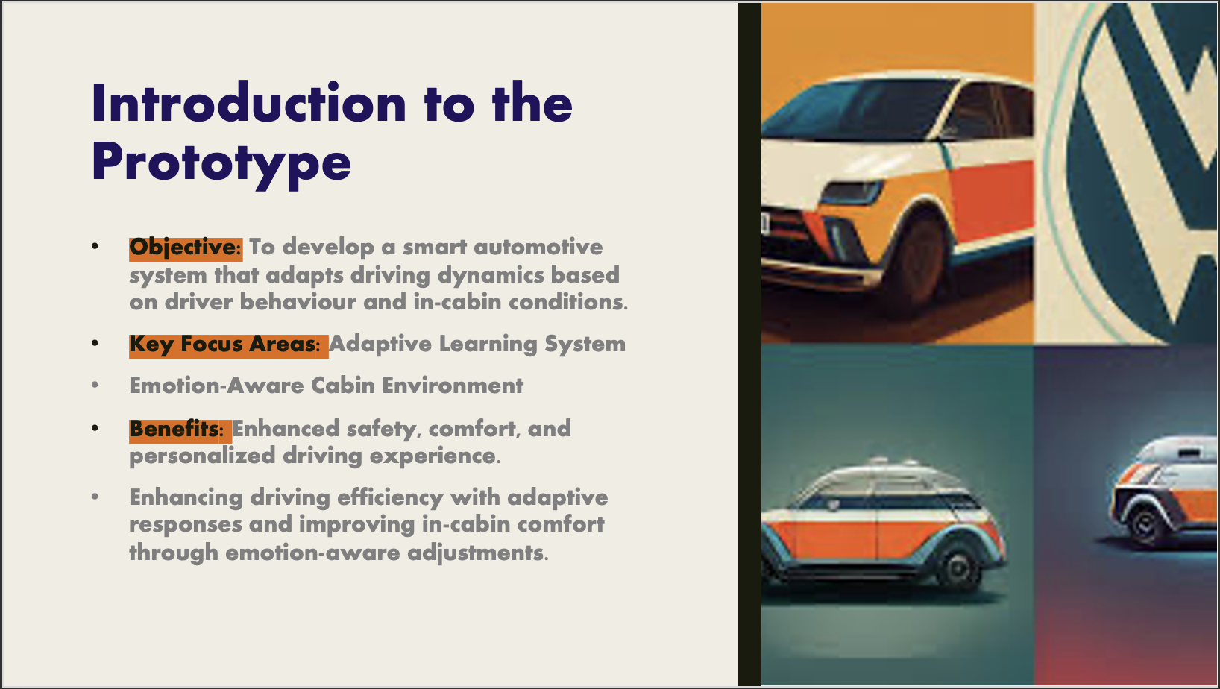
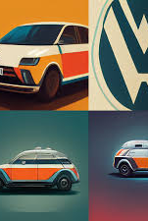
Introduction to the Prototype
Objective: To develop a smart automotive system that adapts driving dynamics based on driver behaviour and in-cabin conditions.
Key Focus Areas: Adaptive Learning System
Emotion-Aware Cabin Environment
Benefits: Enhanced safety, comfort, and personalized driving experience.
Enhancing driving efficiency with adaptive responses and improving in-cabin comfort through emotion-aware adjustments.

Slide 3
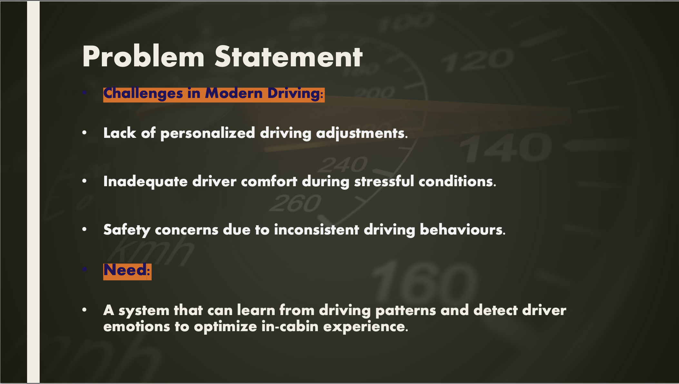
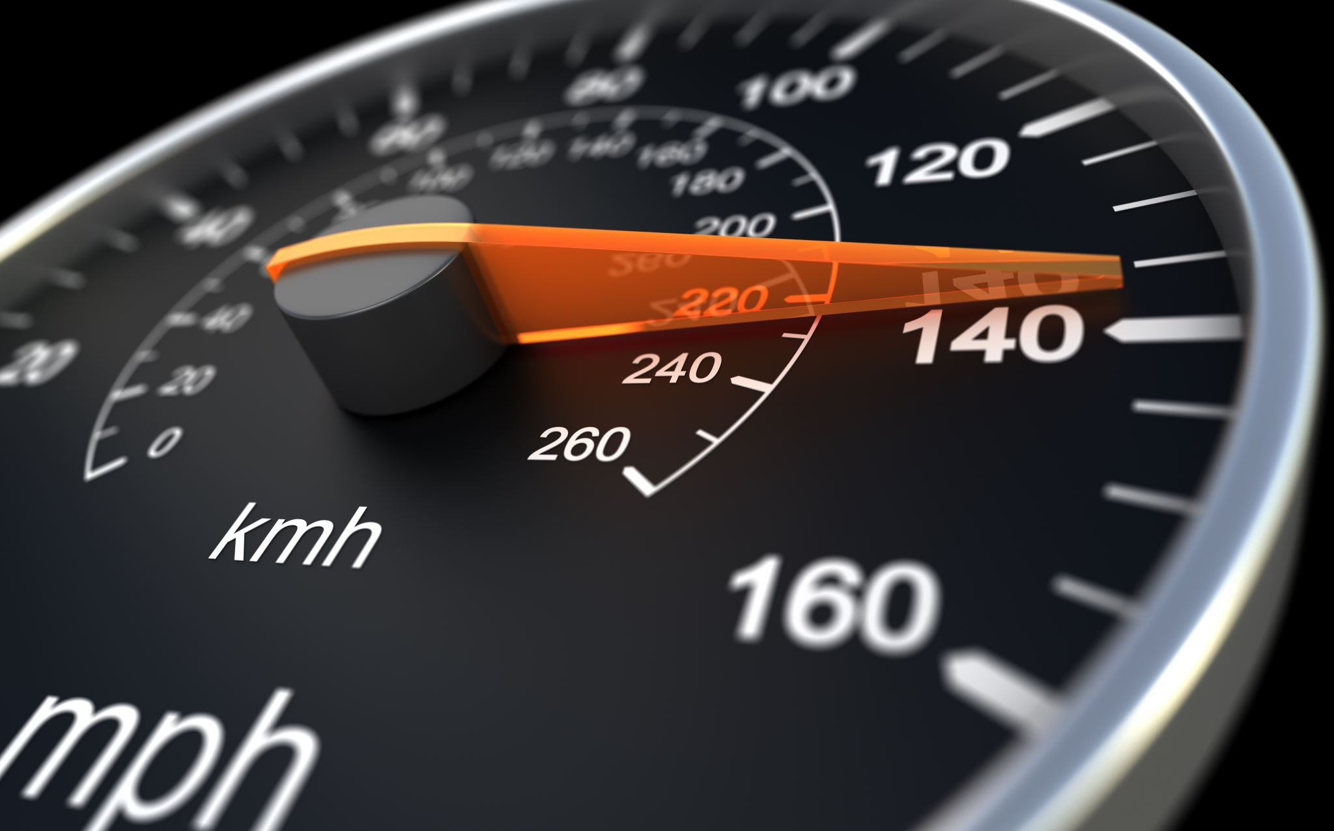
Problem Statement
Challenges in Modern Driving:
Lack of personalized driving adjustments.
Inadequate driver comfort during stressful conditions.
Safety concerns due to inconsistent driving behaviours.
Need:
A system that can learn from driving patterns and detect driver emotions to optimize in-cabin experience.

Slide 4
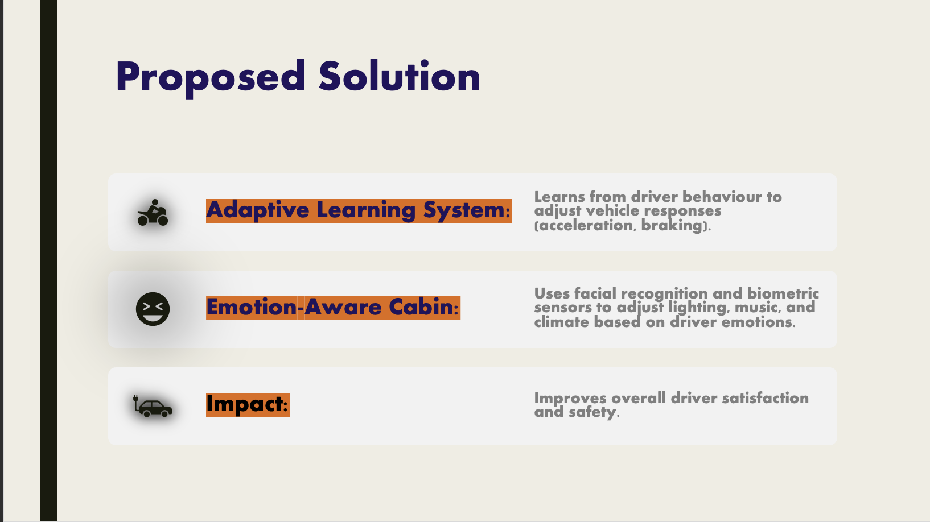
Proposed Solution
Adaptive Learning System:
Learns from driver behaviour to adjust vehicle responses (acceleration, braking).
Emotion-Aware Cabin:
Uses facial recognition and biometric sensors to adjust lighting, music, and climate based on driver emotions.
Impact:
Improves overall driver satisfaction and safety.

Slide 5
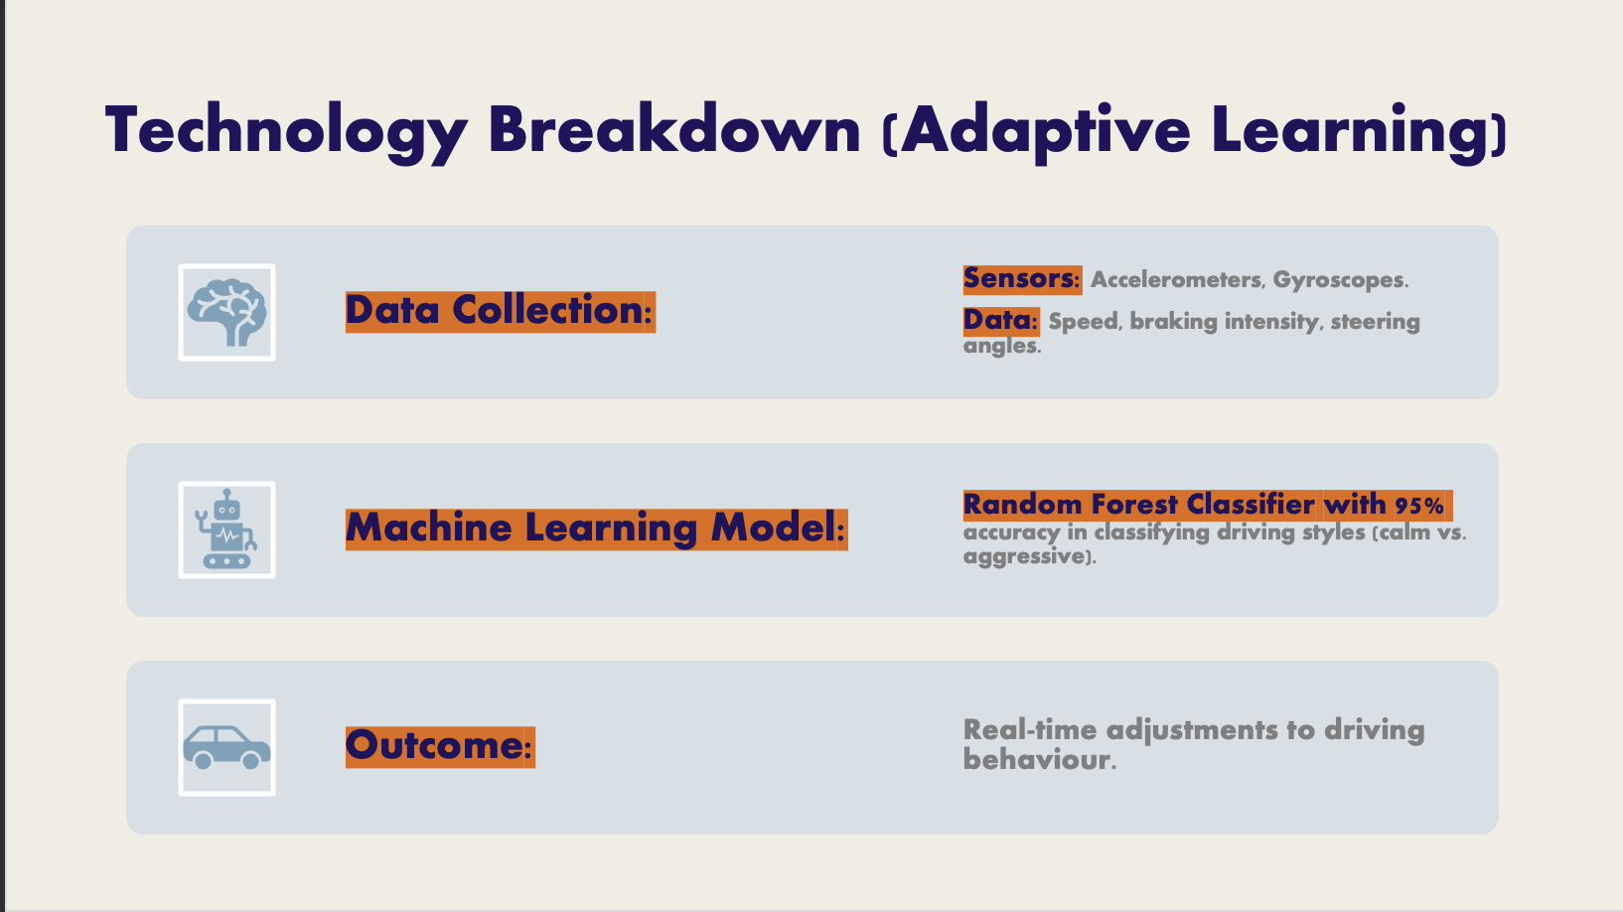
Technology Breakdown (Adaptive Learning)
Data Collection:
Sensors: Accelerometers, Gyroscopes.
Data: Speed, braking intensity, steering angles.
Machine Learning Model:
Random Forest Classifier with 95% accuracy in classifying driving styles (calm vs. aggressive).
Outcome:
Real-time adjustments to driving behaviour.

Slide 6
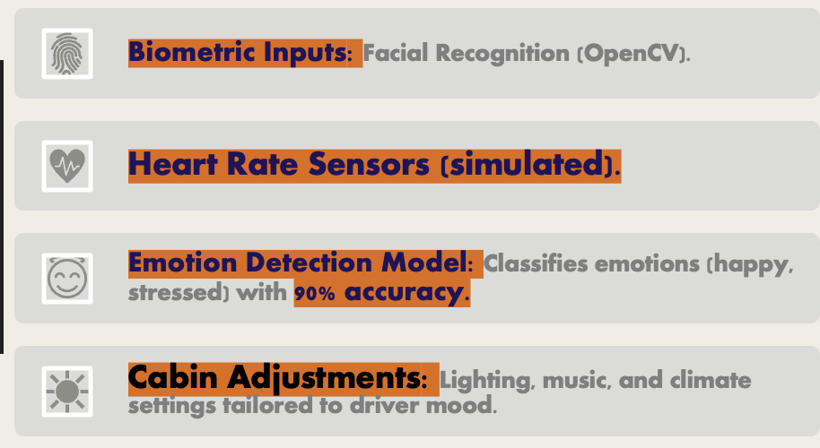
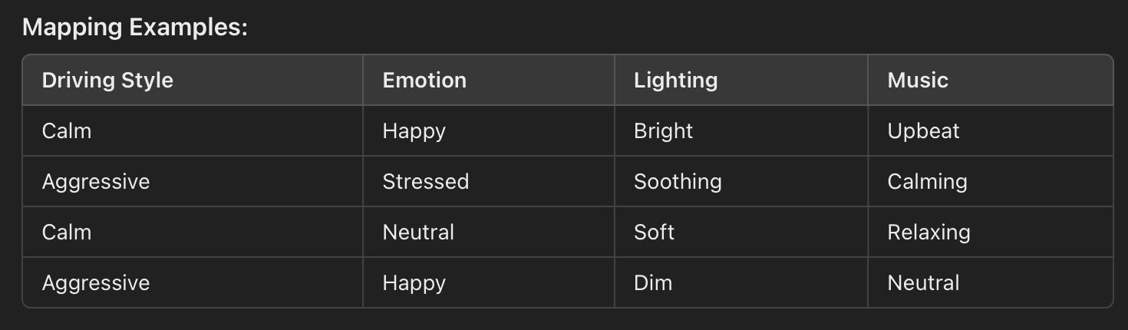
Technology Breakdown (Emotion Detection)
Biometric Inputs: Facial Recognition (OpenCV).
Heart Rate Sensors (simulated).
Emotion Detection Model: Classifies emotions (happy, stressed) with 90% accuracy.
Cabin Adjustments: Lighting, music, and climate settings tailored to driver mood.

Slide 7
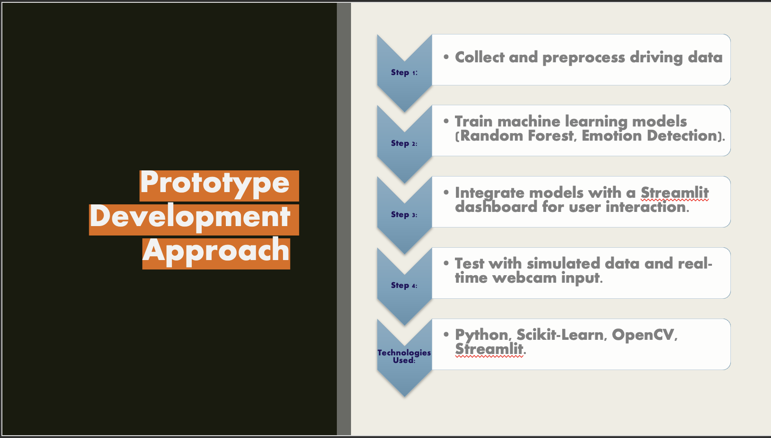
Prototype Development Approach
Step 2:
Step 3:
Step 4:
Technologies Used:
Collect and preprocess driving data
Train machine learning models (Random Forest, Emotion Detection).
Step 1:
Integrate models with a Streamlit dashboard for user interaction.
Test with simulated data and real-time webcam input.
Python, Scikit-Learn, OpenCV, Streamlit.

Slide 8
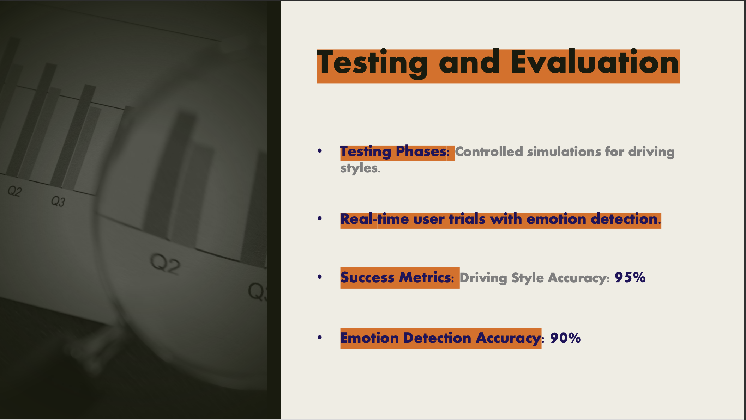

Testing and Evaluation
Testing Phases: Controlled simulations for driving styles.
Real-time user trials with emotion detection.
Success Metrics: Driving Style Accuracy: 95%
Emotion Detection Accuracy: 90%

Slide 9
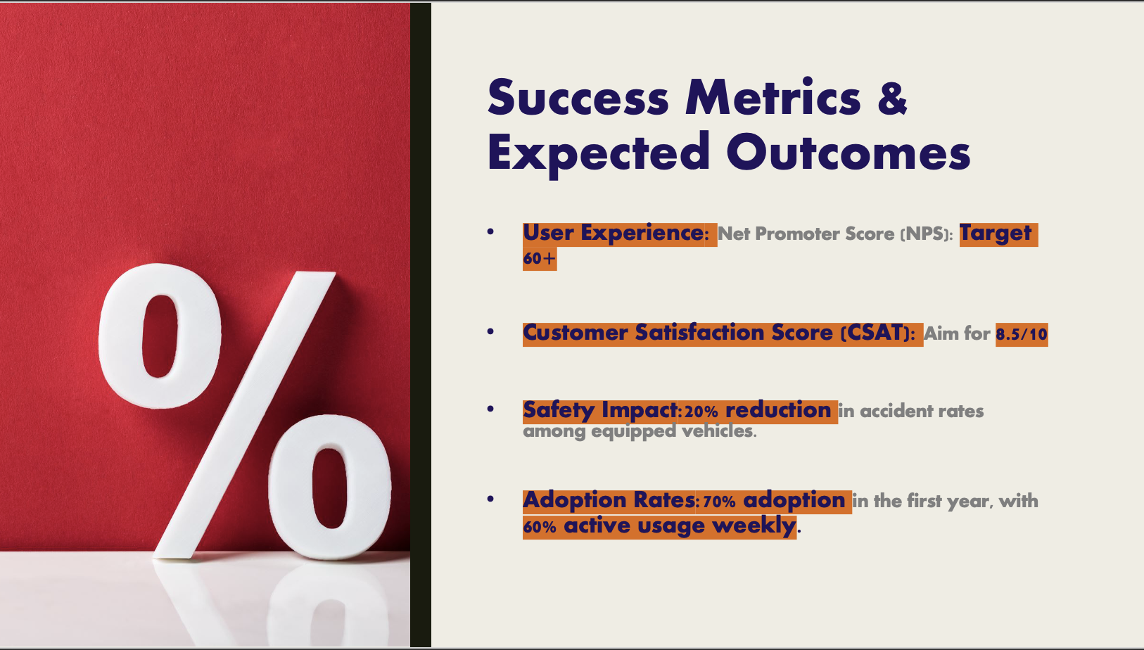

Success Metrics & Expected Outcomes
User Experience: Net Promoter Score (NPS): Target 60+
Customer Satisfaction Score (CSAT): Aim for 8.5/10
Safety Impact:20% reduction in accident rates among equipped vehicles.
Adoption Rates:70% adoption in the first year, with 60% active usage weekly.

Slide 10
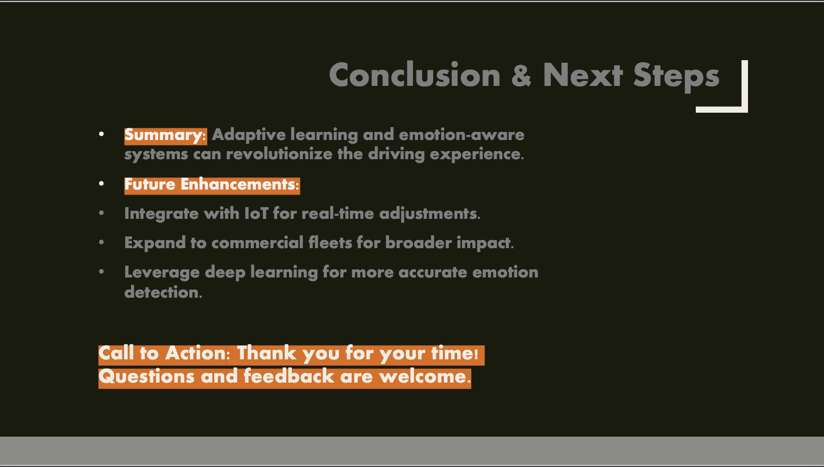
Conclusion & Next Steps
Summary: Adaptive learning and emotion-aware systems can revolutionize the driving experience.
Future Enhancements:
Integrate with IoT for real-time adjustments.
Expand to commercial fleets for broader impact.
Leverage deep learning for more accurate emotion detection.
Call to Action: Thank you for your time! Questions and feedback are welcome.

